Slide 1

The action-oriented approach and the concept of the social agent
CEFR Companion Volume implementation toolbox
Boîte à outils pour la mise en œuvre du volume complémentaire du CECR
© 2023. This work is licensed under an Attribution-NonCommercial-ShareAlike International Creative Commons CC-BY-NC-SA 4.0 License. Attribution: Original activity from Fischer Johann (et al.) (2023), CEFR Companion Volume implementation toolbox, Council of Europe (European Centre for Modern Languages), Graz, available at www.ecml.at/companionvolumetoolbox.

Slide 2
The action-oriented approach
Council of Europe (2020: 28):
“The CEFR’s action-oriented approach represents a shift away from syllabuses based on a linear progression through language structures, or a pre-determined set of notions and functions, towards syllabuses based on needs analysis, oriented towards real-life tasks and constructed around purposefully selected notions and functions. This promotes a “proficiency” perspective guided by “can do” descriptors rather than a “deficiency” perspective focusing on what the learners have not yet acquired. The idea is to design curricula and courses based on real-world communicative needs, organised around real-life tasks and accompanied by “can do” descriptors that communicate aims to learners. Fundamentally, the CEFR is a tool to assist the planning of curricula, courses and examinations by working backwards from what the users/learners need to be able to do in the language.”

Slide 3
The action-oriented approach
Council of Europe (2020: 28):
“The CEFR’s action-oriented approach represents a shift away from syllabuses based on a linear progression through language structures, or a pre-determined set of notions and functions, towards syllabuses based on needs analysis, oriented towards real-life tasks and constructed around purposefully selected notions and functions. This promotes a “proficiency” perspective guided by “can do” descriptors rather than a “deficiency” perspective focusing on what the learners have not yet acquired. The idea is to design curricula and courses based on real-world communicative needs, organised around real-life tasks and accompanied by “can do” descriptors that communicate aims to learners. Fundamentally, the CEFR is a tool to assist the planning of curricula, courses and examinations by working backwards from what the users/learners need to be able to do in the language.”

Slide 4
The action-oriented approach
Key aspects of this quote:
real-life tasks
a “proficiency” perspective
purposefully selected notions and functions and
real-world communicative needs

Slide 5
The action-oriented approach
The new role of the learner as a social agent:
learners simulate a real-life situation,
complete purposeful / meaningful tasks and
show what they are capable to do

Slide 6
The action-oriented approach
Learners:
analyse a specific situation in a given context
are given a scenario
have to complete a task with a specific aim
draw upon their individual knowledge, cultures, skills and interests,
interact with their partner(s) or group
co-construct meaning and concepts
and then present their outcomes to a specific target group
In this way, they act as social agents.
→ Three key notions: “scenario”, “task”, “social agent”

Slide 7
The action-oriented approach and the notion of “scenario”
Learners are put into a concrete real-life situation and simulate the interaction in their team and with the target audience.
A scenario requires clear information about
the context,
the situation,
the roles of the learners and of the target audience,
the tasks and
the objectives.

Slide 8
The action-oriented approach and the notion of “tasks”
“A task is an activity which requires learners to use language, with emphasis on meaning, to attain an objective.”
(Skehan 2003: 3)
“Tasks […] are activities which have meaning as their primary focus. Success in tasks is evaluated in terms of achievement of an outcome, and tasks generally bear some resemblance to real-life language use. So task-based instruction takes a fairly strong view of communicative language teaching.”
(Skehan 1996: 20)

Slide 9
The action-oriented approach and the concept of the social agent
The CEFR (and the CEFR Companion Volume) consider the learners as social agents:
“[…] the CEFR broadens the perspective of language education in a number of ways, not least by its vision of the user/learner as a social agent, co-constructing meaning in interaction, and by the notions of mediation and plurilingual/ pluricultural competences.”
(Council of Europe 2020: 22)
→ two relevant notions in our context: “social agent”, “co-constructing meaning”

Slide 10
The action-oriented approach and the concept of the social agent
“In addition to promoting the teaching and learning of languages as a means of communication, the CEFR brings a new, empowering vision of the learner. The CEFR presents the language user/learner as a “social agent”, acting in the social world and exerting agency in the learning process. This implies a real paradigm shift in both course planning and teaching by promoting learner engagement and autonomy.”
(Council of Europe 2020: 28)

Slide 11
The action-oriented approach and the concept of the social agent
“In addition to promoting the teaching and learning of languages as a means of communication, the CEFR brings a new, empowering vision of the learner. The CEFR presents the language user/learner as a “social agent”, acting in the social world and exerting agency in the learning process. This implies a real paradigm shift in both course planning and teaching by promoting learner engagement and autonomy.”
(Council of Europe 2020: 28)

Slide 12
The action-oriented approach and the concept of the social agent
→ What exactly do we understand by “social agent”?

Slide 13
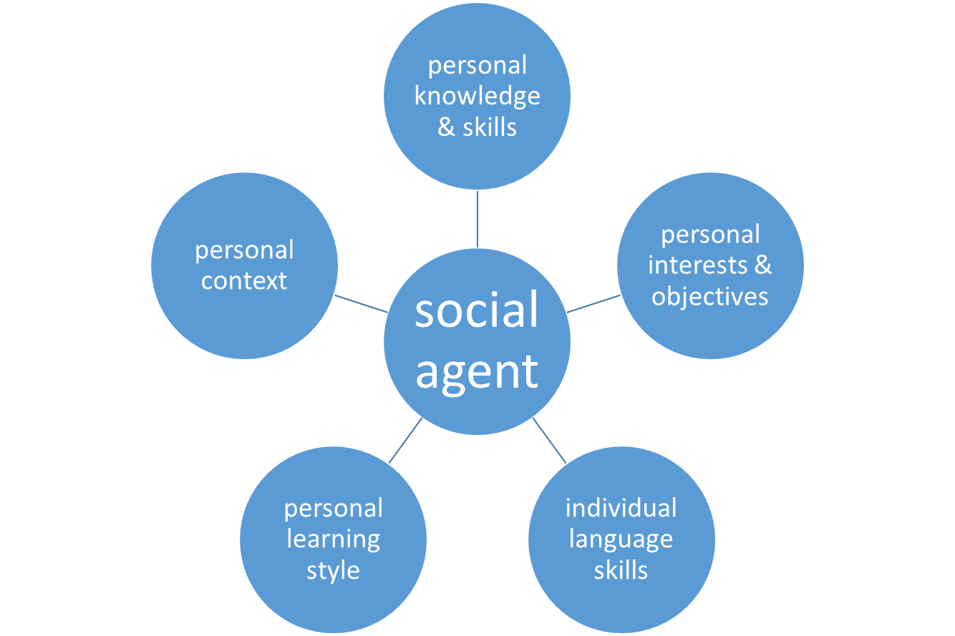
The learner as a social agent
All activities focus on the learner
with his / her individual
skills, knowledge,
interests…
See: Fischer (2021b): 252; Fischer / Wolder (2021): 11; Fischer / Wolder (2022): 196.

Slide 14
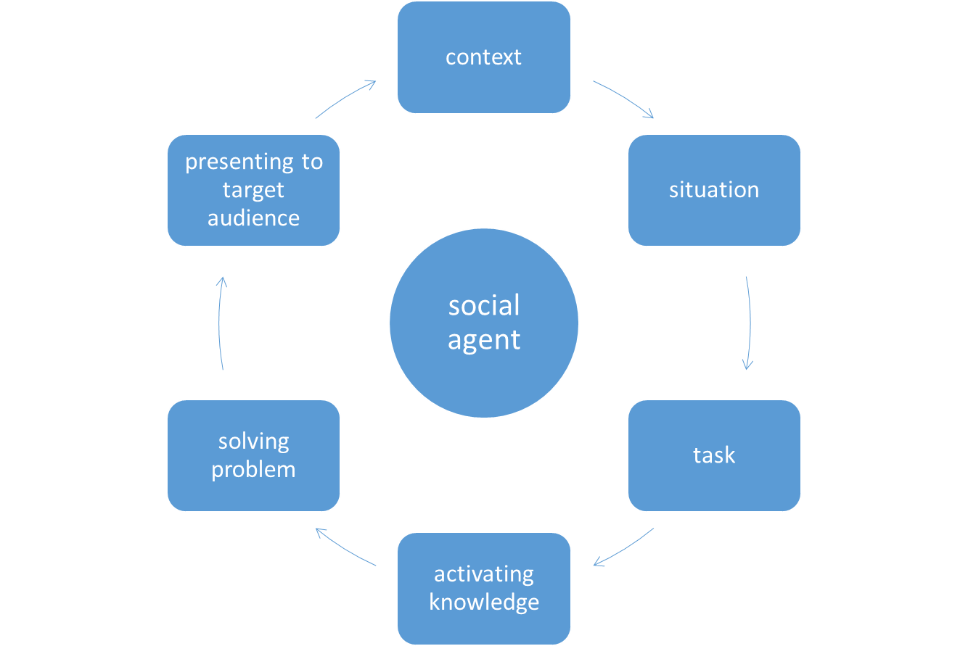
The learner as a social agent
This concept puts the
learner at the centre
of the learning
process:
See: Fischer / Wolder (2022): 196.

Slide 15



The learner as a social agent
mobilising linguistic and pragmatic resources in a pluricultural and plurilingual repertoire – completing collaboratively
a real-life task or project
interaction: negotiation of meaning
mediation:
co-construction of meaning

Slide 16
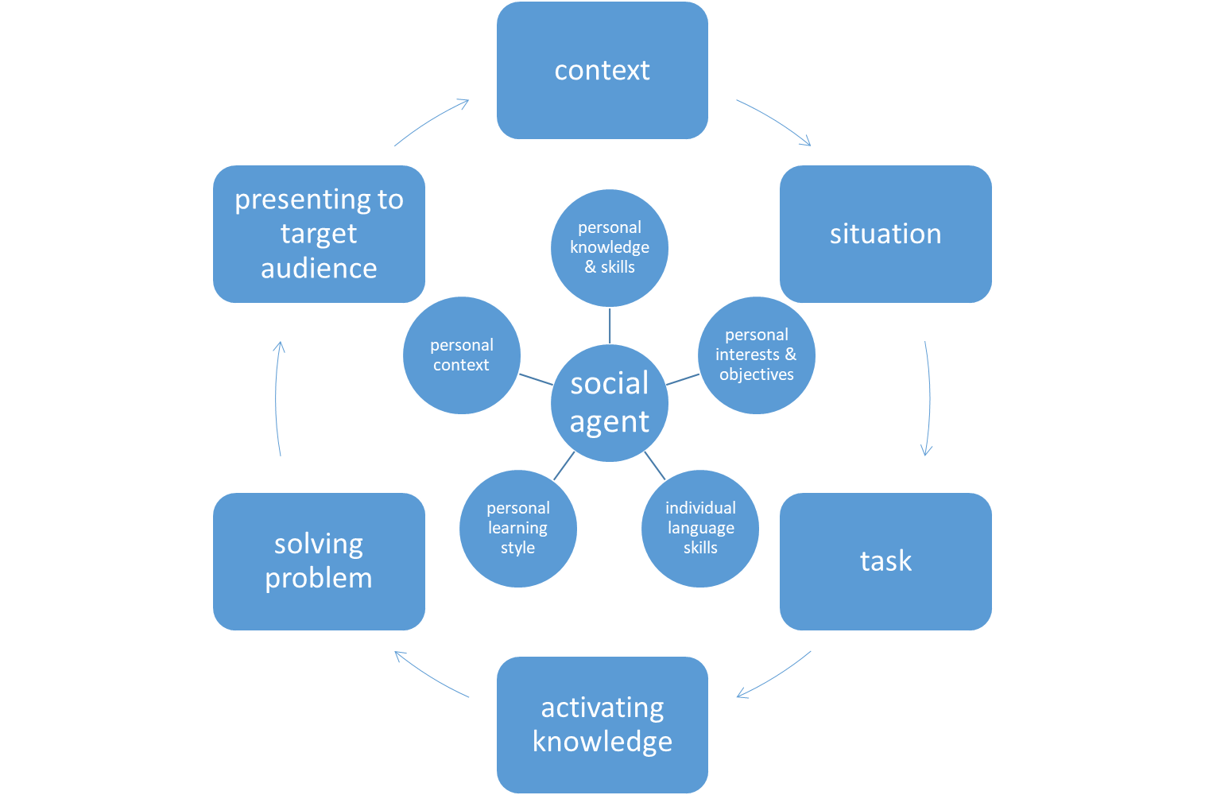
The learner as a social agent
The activities carried
out in class are
influenced by the
different skills,
background knowledge
and interests of the
learners.
See: Fischer (2021b): 254; Fischer / Wolder (2022): 197.

Slide 17
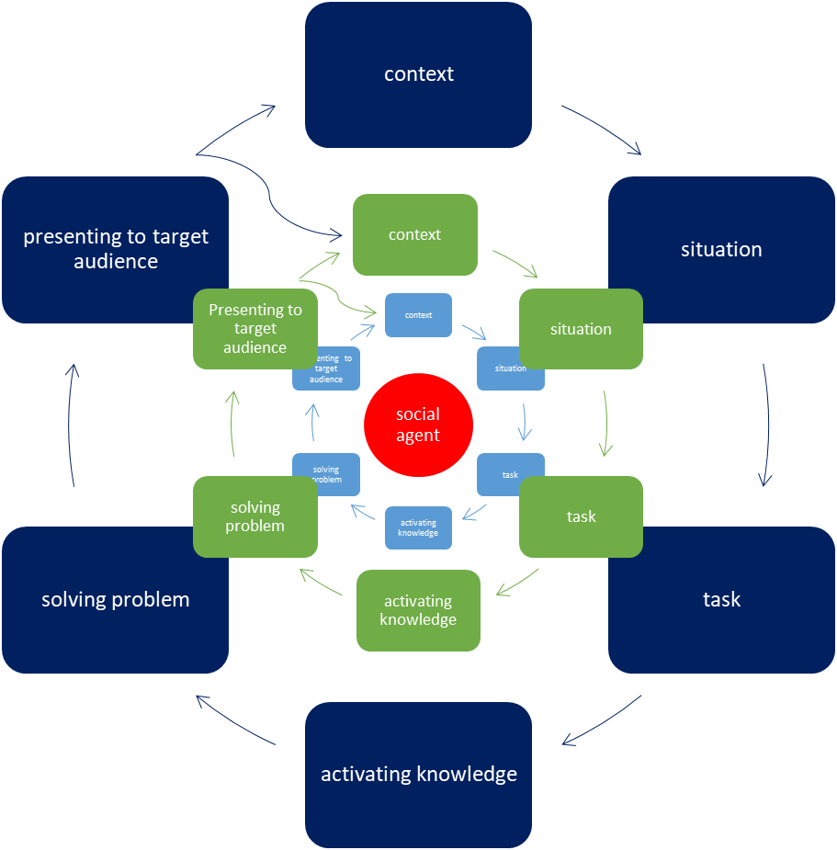
The learner as a social agent
Each activity leads to
the next one,
they are interrelated
and impact one
another.
See: Fischer / Wolder (2022): 197.

Slide 18
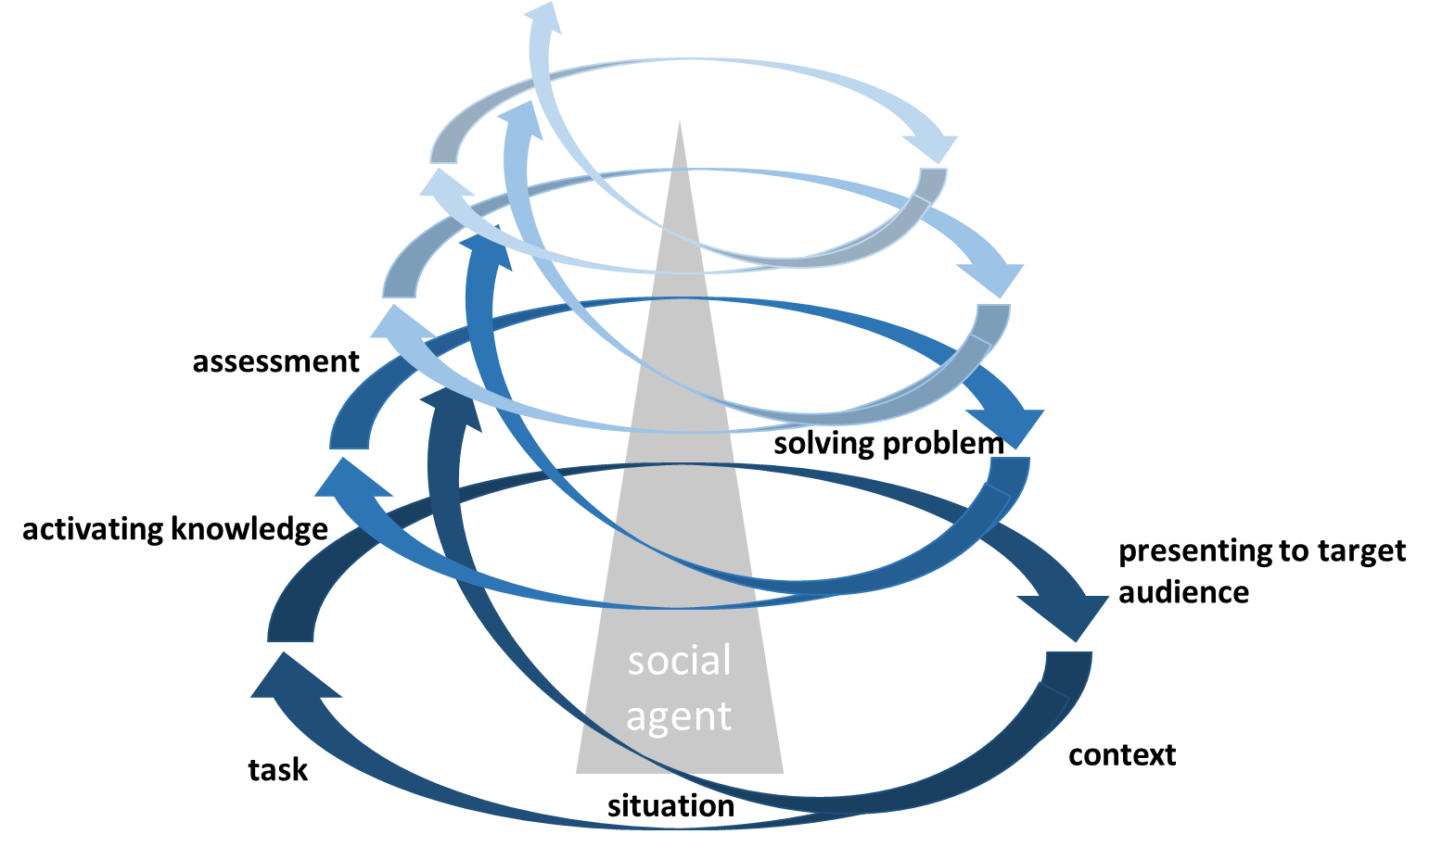
The learner as a social agent
The learning and
teaching activities
follow a cyclical
process.
adapted from:
Fischer / Wolder (2022): 198.

Slide 19
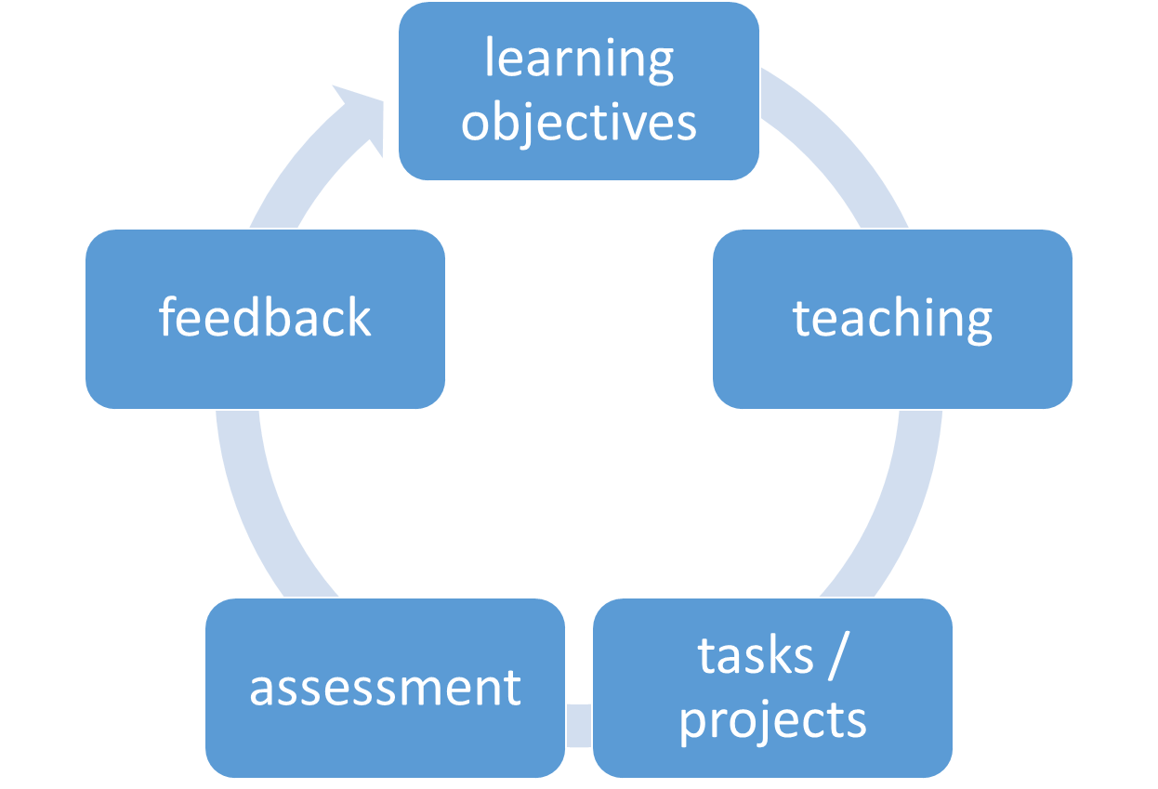
The action-oriented approach: constructive alignment
Coherence between the
different aspects of teaching,
learning and assessment
is required.
See: Fischer / Wolder (2022): 198.

Slide 20
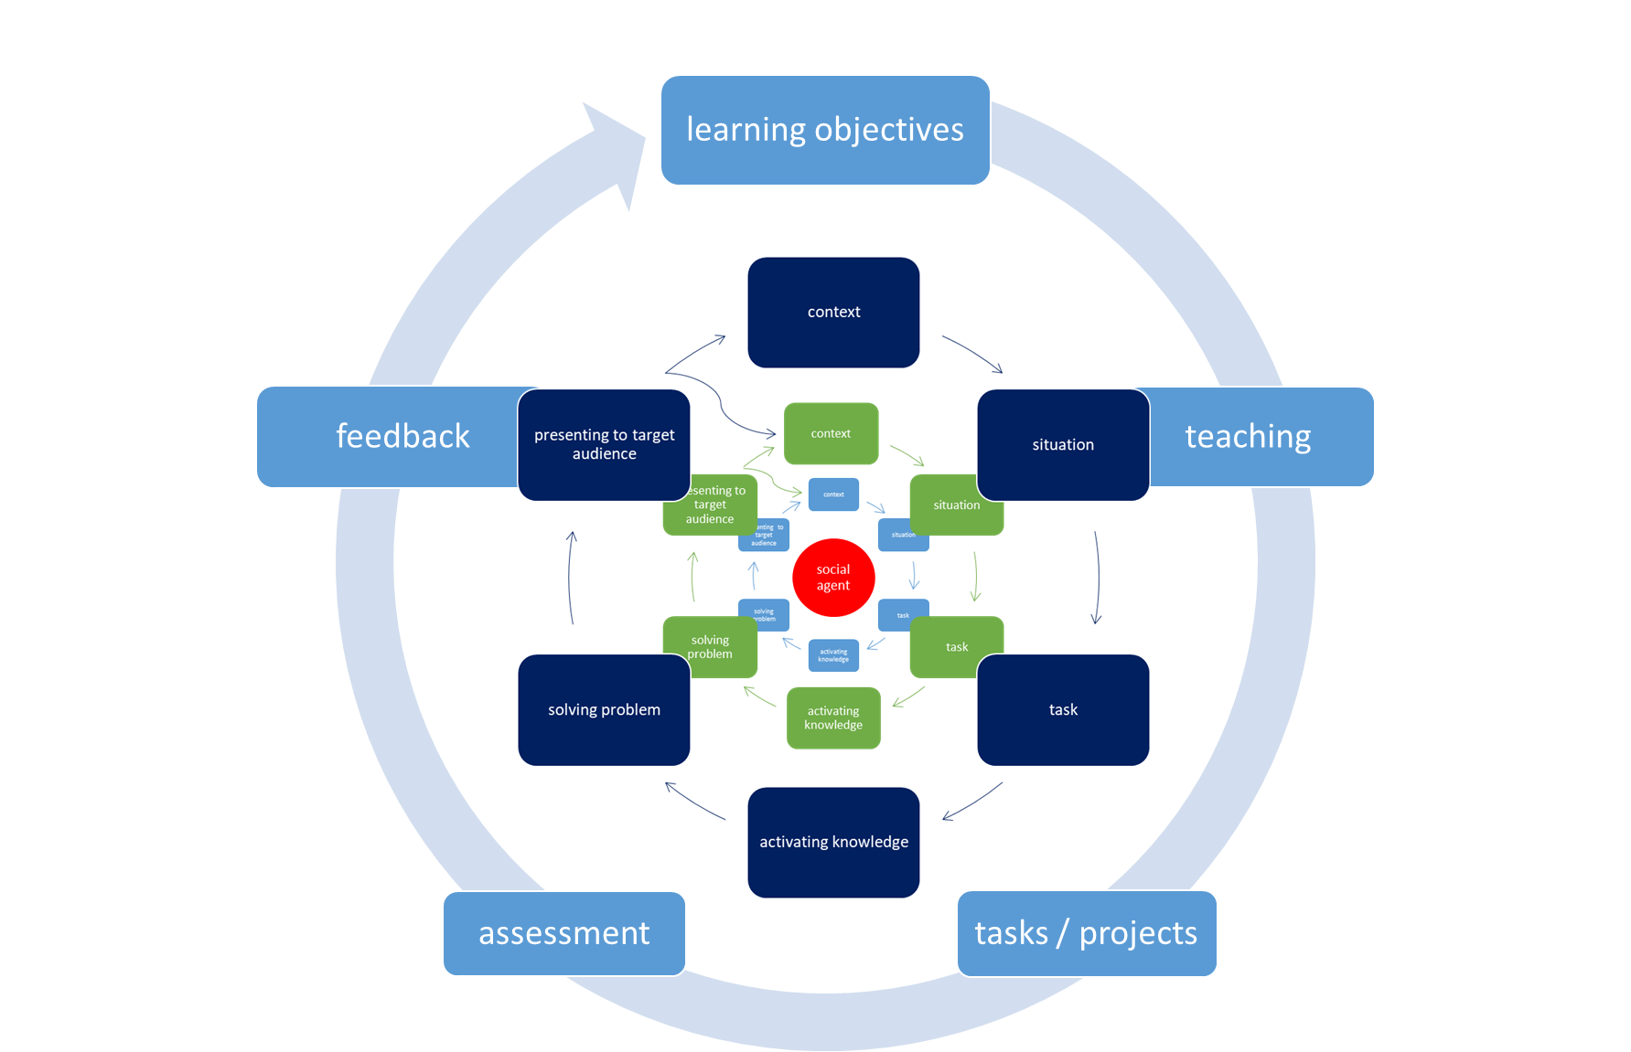
The action-oriented approach: constructive alignment
The concept of constructive
alignment (Biggs 1996)
constitutes the
framework of the
learning, teaching and
assessment activities.
See: Fischer / Wolder (2021): 10.

Slide 21
The action-oriented approach and the concept of the social agent: scenario-based
Key elements of task development in an action-oriented approach:
The learners are given a scenario that explains the issue to develop or the problem to solve.
The learners have to complete a realistic task of a certain complexity in their field of study or their future profession, or of their societal setting.
The tasks require the learners to activate their individual knowledge, culture, skills and interests and develop individual solutions to a given challenge or problem.
The tasks have to be relevant and meaningful to the learner.

Slide 22
The action-oriented approach and the concept of the social agent: scenario-based
Key elements of a scenario that need to be considered in task development in an action-oriented approach:
Context
Situation
Role(s)
Task(s): overall task and build-up tasks
Target group
Expected outcomes / outputs

Slide 23
The action-oriented approach and the concept of the social agent: scenario-based
“While the work on integrated skills assessments has highlighted the importance of tasks designed to measure the learners’ ability to understand source material to communicate ideas in writing and speaking (e.g., reading to summarize in writing), this perspective has concentrated somewhat narrowly on skill integration and performance. Scenario-based assessment (SBA) takes this a step further by orchestrating skill integration within a thematically coherent, socially familiar, purpose-driven scenario in which participants are required to complete a sequence of subtasks intended to reflect the habits of mind underlying the overarching scenario goal […].”
Purpura (2016 : 200)

Slide 24
The action-oriented approach and the concept of the social agent: scenario-based
“While the work on integrated skills assessments has highlighted the importance of tasks designed to measure the learners’ ability to understand source material to communicate ideas in writing and speaking (e.g., reading to summarize in writing), this perspective has concentrated somewhat narrowly on skill integration and performance. Scenario-based assessment (SBA) takes this a step further by orchestrating skill integration within a thematically coherent, socially familiar, purpose-driven scenario in which participants are required to complete a sequence of subtasks intended to reflect the habits of mind underlying the overarching scenario goal […].”
Purpura (2016 : 200)

Slide 25
The action-oriented approach and the concept of the social agent – Bibliography (1/2)
Biggs, John B. (1996): Enhancing Teaching Through Constructive Alignment. Higher Education 32, 247-264.
Council of Europe (2001): Common European Framework of Reference for Languages: Learning, teaching, assessment. Cambridge: CUP.
Council of Europe (2020): Common European Framework of Reference for Languages: Learning, Teaching, Assessment. Companion Volume. Strasbourg: Council of Europe.
Fischer, Johann (2021a): The underlying action-oriented and task-based approach of the CEFR and its implementation in language testing and assessment at university. Language Learning in Higher Education 10 (2), 301-316.
Fischer, Johann (2021b): The Language Learner as a Social Agent – neuer Blick auf die Lernenden dank des Companion Volumes zum GER. In: Brandt, Anikó / Buschmann-Göbels, Astrid / Harsch, Claudia (eds.): Rethinking the Language Learner: Paradigmen – Methoden – Disziplinen. Erträge des 7. Bremer Symposions. Bochum: AKS-Verlag, 246-259.
Fischer, Johann / Wolder, Nicole (2021): Erfahrungen in der Umsetzung der Inhalte des Begleitbands zum GeR im Hochschulkontext – Ergebnisse eines Projektes des Europarates und Handlungsbedarf für Hochschulsprachenzentren. Fremdsprachen und Hochschule 96, 7-27.

Slide 26
The action-oriented approach and the concept of the social agent – Bibliography (2/2)
Fischer, Johann / Wolder, Nicole (2022): Implementation of the CEFR Companion Volume in the UNIcert® and NULTE Networks. In: North, Brian / Piccardo, Enrica / Goodier, Tim / Fasoglio, Daniela / Margonis-Pasinetti, Rosanna / Rüschoff, Bernd (eds.): Enriching 21st century language education. The CEFR Companion Volume in practice, Strasbourg: Council of Europe Publishing, 185-201; https://rm.coe.int/enriching-21st-century-language-education-the-cefr-companion-volume-in/1680a68ed0.
Graves, Kathleen (2008): The language curriculum: A social contextual perspective. Language Teaching 41 (2), 147-181.
Piccardo, Enrica / North, Brian (2019): The Action-oriented Approach. A Dynamic Vision of Language Education. Bristol: Multilingual Matters.
Purpura, James E. (2016): Assessing Meaning. In: Shohamy, Elana et al. (eds.): Language Testing and Assessment, Encyclopedia of Language and Education. Basel: Springer International Publishing, 33-61.
Skehan, Peter (1996): Second language acquisition research and task-based instruction. In: Willis, Jane / Willis, Dave (eds.): Challenge and Change in Language Teaching. Oxford: Heinemann, 17-30.
Skehan, Peter. 2003. Task-based instruction. Language Teaching 36, 1-14.
Van den Branden, Kris / Bygate, Martin / Norris, John M. (eds.) (2009): Task-Based Language Teaching. A Reader. Amsterdam & Philadelphia: John Benjamins.

